Slide 1




JavaScript Applications: Teamwork defense
Presentation of project “Tanks Game”
Team “Dragonfruit”
Students at Telerik Academy

Slide 2
The team
Vladislav Karamfilov
Angel Stoyanov
Svetoslav Manchev
Hristo Maleev
Kalin Nikolov

Slide 3



Technologies used:
HTML5
CSS3
jQuery
QUnit
Standalone Prototype.js Class System - ProtoClass

Slide 4
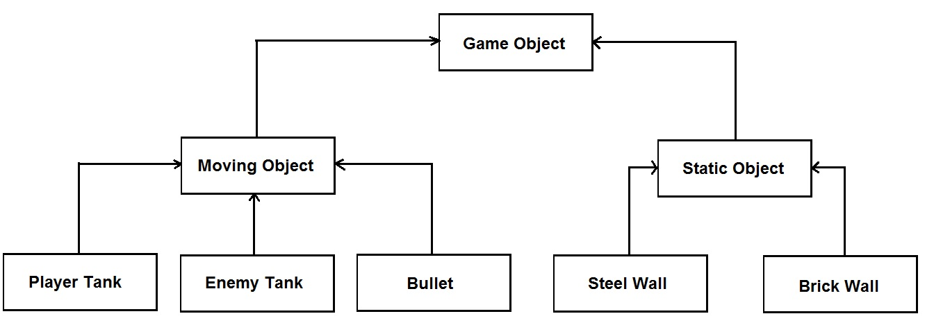
The class diagram

Slide 5
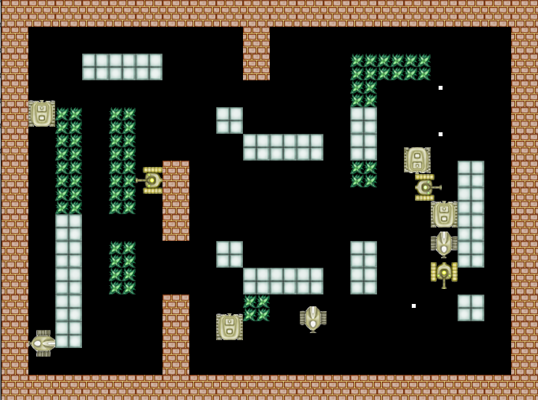
Tanks Game – live demo

Slide 6

SVN repository Demo

Slide 7
Teamwork Presentation
http://academy.telerik.com

